Slide 1
HTML5 Rocks
Cool things about html5
Florrie Cheng
ycheng@vmware.com

Slide 2
Before the session…
https://codepen.io/pen/

Slide 3
HTML
Hypertext Markup Language
Section that will control the organization
Tags for content
Semantic layout
When building an application
Start with thinking through your content
Then begin building the structure

Slide 4
CSS
Cascading Style Sheets
Sections that will control the presentation
Brings style to the content
Describes the HTML elements
When building an application layer on the presentation
Place your external CSS within the head element of your document

Slide 5
JavaScript
Sections that will control the application logic and behavior
Can handle page routing
Handle user interaction
Form submission
When building an application, layer on the behavior and control
Place your external JS within the body element of your document, directly above the closing body element

Slide 6
What is html5?

Slide 7
HTML4
<!DOCTYPE html PUBLIC “-//W3c//DTD HTML 4.01//EN” “http://www.w3.org/TR/html4/strict.dtd”>
<meta http-equiv=“content-type” content=“text/html; charset=UTF-8”>
<link type=“text/css” rel=“stylesheet” href=“app.css”>
HTML5
<!DOCTYPE html>
<meta charset=“utf-8”>
<link rel=“stylesheet” href=“app.css”>

Slide 8
Welcome to the Family
HTML5 is a conglomeration of web technologies
Think of it like this:
Outline:
Semantic markup
Multimedia without plugins
Rich Internet clients: canvas, transforms, JavaScript interfaces
More efficient applications: client-side storage, offline applications, web workers
Advanced CSS: selectors, animations, shadows
Markup + JavaScript APIs + CSS = HTML5

Slide 9
Bad In-laws Not Here
Browsers don’t support HTML5
http://caniuse.com/
http://html5please.com/
IE isn’t going to work
IE9 and above work pretty well
HTML5 isn’t going to be done until 2022
Well ... it might not be finalized, but what we have should be there
I need to relearn everything!
Nope, this is an evolution not a revolution
http://html5doctor.com/

Slide 10
Semantic Markup

Slide 11
Semantic Markup
You don’t need to describe your elements with classes and divs
Use elements with meaning
What are the most common names for class attributes
https://developers.google.com/webmasters/state-of-the-web/ 2005/classes?csw=1
Maybe they should become HTML tags

Slide 12
Semantic Elements
Our building blocks should have meaning
<div> and <span> don’t have much meaning
We can still use them, but not so heavily
We can do better
More meaningful elements means less classes and ids are needed to provide meaning to elements

Slide 13
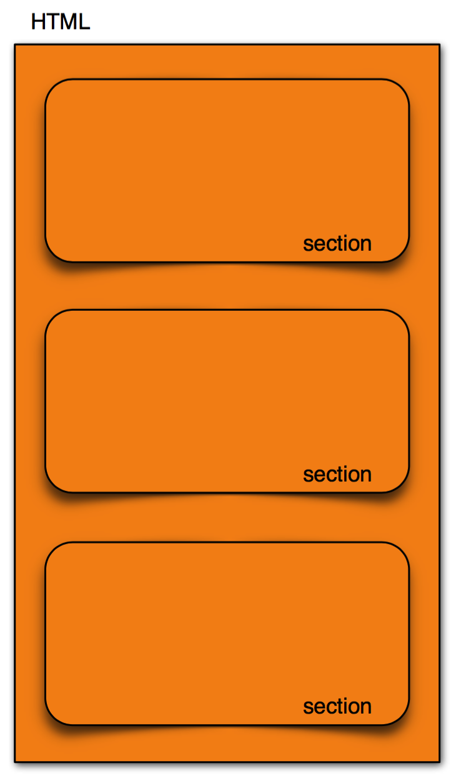
Sectioning Element
<section> is a generic document or application section
Usually used in conjunction with a heading and sometimes a footer
Semantically it is a grouping of logically related content
Example:
Sections of a long article

Slide 14
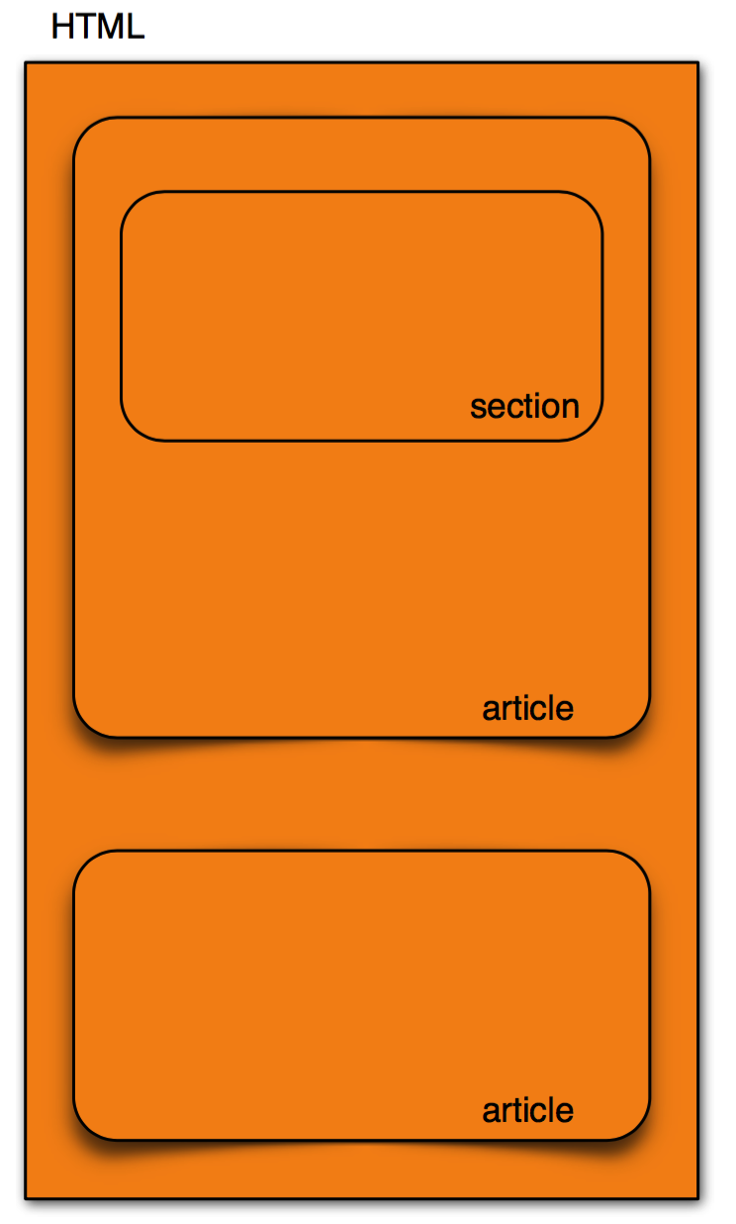
Article Element
<article> is an independent section of the document
A specialized section
They should be able to stand alone without the rest of the page
They should have a heading and could have a footing
Examples:
Journal entry
Blog

Slide 15
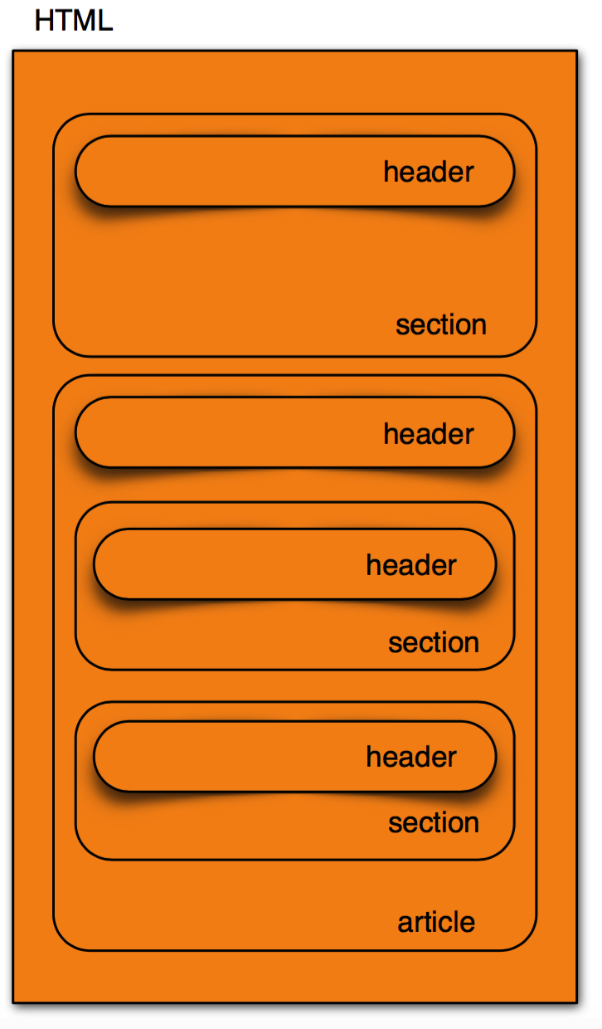
Header
<header> semantically used for introduction and navigation
Used anywhere a heading is needed (e.g. <section>, <article>, <body>)
Can contain other elements (e.g. <h1>, <p>, <nav>)
Can’t contain another <header> or a <footer>

Slide 16
More Sectioning Elements
<nav>
Semantic navigation element
Groups links together for major navigation
Doesn’t have to be a list
<aside>
Used for content directly related to its structural element it is within (i.e. an aside within an article)
Used for secondary content when not nested inside of an <article>

Slide 17
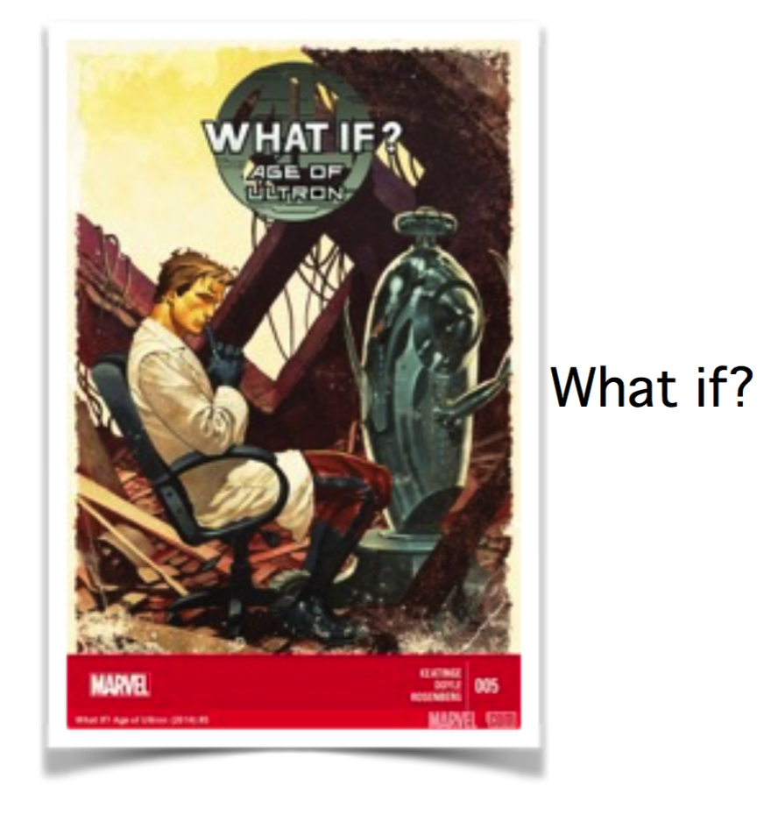
More Structural Elements
<figure> & <figcaption> semantically allows images/charts to have a caption associated with them
<figure>
<img src=“comic.jpg”>
<figcaption>What if?</figcaption>
</figure>

Slide 18
Phrasing Content
HTML4 used <i> and <b> for font styling
Now they have semantic meaning (i.e. they aren’t just presentational)
<i> now for text in an alternate voice (e.g. technical terms, foreign words, taxonomy)
<b> now for stylistically offset text without raising importance (i.e. keywords in a sentence, product names)
The new semantic meaning allows the <i> and <b> to be styled differently than italics and bold
Adding a class allows you to identify its use
<p><b class=“lead”>A breaking story.</b><p>

Slide 19
<hr>
Used to be a horizontal rule
Semantically it means a section break
Browsers style it with a horizontal line, however, with CSS you could replace that with a more stylistic separation
Anywhere a <p> element can go an <hr> element can go
<s>
Used to be a strikethrough
Semantically it means the content is no longer useful or is out of date
The style is simply being unhinged from its semantic meaning
However, browsers are still rendering it with a strikethrough

Slide 20
Block-level links
<a>
In the past links have only been able to surround inline information ... mainly text
We have wanted to simplify the process of creating large clickable objects
HTML5 allows for wrapping flow control content with an <a>
We can wrap div, section, article, p, li ... basically any element
As long as there is no extra interactivity in that flow control content
<a href="/"><img src="spider.jpg”></a>

Slide 21
Semantic Lists
<ol>
Ordered lists have been given a semantic update
type attributes are again allowed:
type = “1” decimal ordering - this is the default
type = “a” lower-case alpha ordering
type = “A” upper-case alpha ordering
type = “i” lower-case roman numeral ordering
type = “I” upper-case roman numeral ordering
<ol type=“I”>
<li>A</li>
<li>B</li>
<li>C</li>
</ol>

Slide 22
<ol reversed>
<li>A</li>
<li>B</li>
<li>C</li>
</ol>
<ol start=“4” >
<li>A</li>
<li>B</li>
<li>C</li>
</ol>
<ol>
<li value=”4”>A</li>
<li>B</li>
<li>C</li>
</ol>

Slide 23
<cite>
Used to give props to a creative reference Books, videos, blogs, tweets ...
Must include a title, an author or URL
Used to highlight or bring attention to text
It doesn’t change the texts importance (e.g. <strong>)or emphasis (e.g. <em>)
Useful for marking up search terms
<mark>

Slide 24
MULTIMEDIA
without plugin

Slide 25
HTML5 vs Flash
Adobe Flash has been the only way to let rich audio and video content run on the web for more than a decade.
HTML5 can be used as an alternative to Adobe Flash.
Both include features for playing audio and video within web pages, and integrated vector graphics.
Notes:
"HTML5" in this article sometimes refers not only to the HTML5 specification, which does not itself define ways to do animation and interactivity within web pages, but to HTML5 and related standards like JavaScript or CSS 3. Animation via JavaScript is also possible with HTML 4.

Slide 26
Mobile Space
HTML5 video content is better on battery life in contrast to Flash.

Slide 27
Compatibility
Flash
Many different versions of the Adobe Flash Player make life hard for the user as newly converted videos do not run on elder Flash versions.
Adobe Flash may often be installed but not in the right version which is often overlooked by web admins.
HTML5
it’s still not universally supported
The key markets here are Internet Explorer 6, Internet Explorer 7 and Internet Explorer 8

Slide 29
Market
Using HTML5 for video playing
Youtube, Facebook, …
Using Flash for video playing
Most of video websites in China(including weibo, bilibili, youku, …)
Real time video broadcasting
Web RTC is an HTML5 solution but not stable enough

Slide 30
Web Audio Example
<audio controls> <source src="horse.ogg" type="audio/ogg"> <source src="horse.mp3" type="audio/mpeg"> Your browser does not support the audio element. </audio>
Web Audio API
Provide a powerful and versatile system for controlling audio on the Web, allowing developers to choose audio sources, add effects to audio, create audio visualizations, apply spatial effects (such as panning) and much more.

Slide 31
Web Audio API
A simple, typical workflow for web audio would look something like this:
Create audio context
Inside the context, create sources — such as <audio>, oscillator, stream
Create effects nodes, such as reverb, biquad filter, panner, compressor
Choose final destination of audio, for example your system speakers
Connect the sources up to the effects, and the effects to the destination.

Slide 32
Web Video Example
var p = navigator.mediaDevices.getUserMedia(
{ video: true });
p.then(function(mediaStream) {
var video = document.querySelector('video');
video.src = window.URL.createObjectURL(mediaStream);
video.onloadedmetadata = function(e) {
// Do something with the video here.
console.log("on loaded meta data");
video.play();
};
});
https://html5-demos.appspot.com/static/getusermedia/photobooth.html

Slide 33
Canvas

Slide 34
Overview
Canvas is a 2D drawing API recently added to HTML and supported by most browsers (even Internet Explorer 9 beta).
Canvas allows you to draw anything you want directly in the web browser without the use of plugins like Flash or Java.
With its deceptively simple API, Canvas can revolutionize how we build web applications for all devices, not just desktops.

Slide 35
Quick Example
<html>
<body>
<canvas width=“800” height=“600” id=“canvas”></canvas>
<script>
var canvas = document.getElementById('canvas');
var c = canvas.getContext('2d');
c.fillStyle = "red";
c.fillRect(100,100,400,300);
</script>
</body>
</html>

Slide 36
Other three ways to draw things
SVG: SVG is a vector API that draws shapes. Each shape has an object that you can attach event handlers to. If you zoom in the shape stays smooth, whereas Canvas would become pixelated.
CSS: CSS is really about styling DOM elements. Since there are no DOM objects for things you draw in Canvas you can't use CSS to style it. CSS will only affect the rectanglar area of the Canvas itself, so you can set a border and background color, but that's it.
DOM animation: The DOM, or Document Object Model, defines an object for everything on the screen. DOM animation, either by using CSS or JavaScript to move objects around, can be smoother in some cases than doing it with Canvas, but it depends on your browser implementation.
Notes:
Canvas : draw with pixels Well, Canvas is lower level than those others so you can have more control over the drawing and use less memory, but at the cost of having to write more code.
Use SVG when you have existing shapes that you want to render to the screen, like a map that came out of Adobe Illustrator.
Use CSS or DOM animation when you have large static areas that you wish to animate, or if you want to use 3D transforms.
For charts, graphs, dynamic diagrams, and of course video games, Canvas is a great choice.
And later on we will discuss a few libraries to let you do the more vector / object oriented stuff using Canvas.

Slide 37
Paths
c.fillStyle = 'red';
c.beginPath();
c.moveTo(10,30);
c.bezierCurveTo(50,90,159,-30,200,30); c.lineTo(200,90);
c.lineTo(10,90);
c.closePath();
c.fill();
c.lineWidth = 4;
c.strokeStyle = 'black';
c.stroke();

Slide 38
Images
var image = new Image();
image.src = "images/Sinistar/Hunter1.bmp";
c.drawImage(
image, //draw stretched
0,0,66,66, //source (x,y,w,h)
100,0,100,100//destination (x,y,w,h)
);

Slide 39
Opacity
c.fillStyle = 'red';
//divide by 100 to get a fraction between 0 and 1
c.globalAlpha = 50/100;
c.fillRect(0,0,50,50);
c.globalAlpha = 30/100;
c.fillRect(25,25,50,50);
c.globalAlpha = 1.0;

Slide 40
Translate & Rotate
c.fillStyle = "red";
c.translate(100,0);
//convert degrees to radiansvar
rads = 30 * Math.PI*2.0/360.0;
c.rotate(rads)
c.fillRect(0,0,100,100);

Slide 41
Animation
window.requestAnimFrame = (function(){
return window.requestAnimationFrame ||
window.webkitRequestAnimationFrame ||
window.mozRequestAnimationFrame ||
window.oRequestAnimationFrame ||
window.msRequestAnimationFrame ||
function( callback ){
window.setTimeout(callback, 1000 / 60);
};
})();
var x = 0;
function drawIt() {
window.requestAnimFrame(drawIt);
c.clearRect(0,0,canvas.width,canvas.height);
c.fillStyle = "red";
c.fillRect(x,100,200,100);
x+=5;
}
window.requestAnimFrame(drawIt);

Slide 42
Drawing something over and over
classic particle simulator algorithm

Slide 43
var particles = [];
var tick = 0;
function loop() {
window.requestAnimFrame(loop);
createParticles();
updateParticles();
killParticles();
drawParticles();
}
window.requestAnimFrame(loop);

Slide 44
Pixel Buffers and Other Effects
imageData = c.createImageData(x,y);
imageData = c.getImageData (x,y,w,h)
imageData: [pixels]
pixel: [red, green, blue, alpha] // 0 – 255
c.putImageData(imageData,x,y);

Slide 45
Combine Canvas with Multimedia
http://neave.com/

Slide 46
Librarys
Fabric.js
Paper.js
EaselJS
And so on…

Slide 47
Make WEB applications MORE efficient

Slide 48
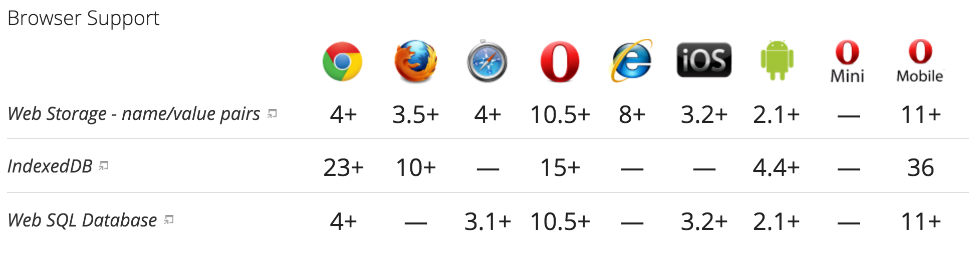
Offline Application
HTML5 and related specs introduce a number of features to make offline web apps a reality:
Application cache
Local storage
Web SQL & indexed database
Online/offline events

Slide 49
Local Storage
versus Cookies
Strength of local storage
More secure
No affecting website performance
Per origin (per domain and protocol)
Cookies | Local Storage
included in every server request | never transferred to the server
Small amounts of data | large amounts of data (at least 5MB)

Slide 50
Example
if(typeof(Storage) !== "undefined") { // Code for localStorage/sessionStorage.
// Store localStorage.setItem(“lastname”, “Smith”); // Retrieve document.getElementById(“result”).innerHTML = localStorage.getItem(“lastname”); } else { // Sorry! No Web Storage support..
document.getElementById("result").innerHTML =
"Sorry, your browser does not support Web Storage..."; }

Slide 51
Example 2
// Store localStorage.lastname = "Smith"; // Retrieve document.getElementById("result").innerHTML =
localStorage.lastname;

Slide 52
Application Cache
<html manifest="example.appcache">
...
</html>
If an application cache exists, the browser loads the document and its associated resources directly from the cache, without accessing the network. This speeds up the document load time.
The browser then checks to see if the cache manifest has been updated on the server.
If the cache manifest has been updated, the browser downloads a new version of the manifest and the resources listed in the manifest. This is done in the background and does not affect performance significantly.

Slide 53
Storage location
Firefox
the offline cache data is stored separately from the Firefox profile—next to the regular disk cache:
Windows:
C:\Users\<username>\AppData\Local\Mozilla\Firefox\Profiles\<salt>.<profile name>\OfflineCache
Mac/Linux:
/Users/<username>/Library/Caches/Firefox/Profiles/<salt>.<profile name>/OfflineCache
Chrome
chrome://appcache-internals/

Slide 54
Cache manifest file
CACHE MANIFEST
# v1 2011-08-14
# This is another comment
index.html
cache.html
style.css
image1.png
# Use from network if available
NETWORK:
/api
network.html
# Fallback content
FALLBACK:
/ fallback.html

Slide 55
Service Workers
An experimental technology that provides a more reliable solution to offline application than AppCache
Service Worker syntax is more complex than that of AppCache.
The trade off is that you can use JavaScript to control your AppCache-implied behaviours with a fine degree of granularity, allowing you to handle this problem and many more.
Using a Service Worker you can easily set an app up to use cached assets first, thus providing a default experience even when offline, before then getting more data from the network (commonly known as Offline First).

Slide 56
Preparation
Firefox Nightly: Go to about:config and set dom.serviceWorkers.enabled to true; restart browser.
Chrome Canary: Go to chrome://flags and turn on experimental-web-platform-features; restart browser (note that some features are now enabled by default in Chrome.)
Opera: Go to opera://flags and enable Support for ServiceWorker; restart browser.

Slide 57
Service Workers Example
https://github.com/mdn/sw-test/

Slide 58
Other Useful Websites
http://www.w3schools.com/html/
http://html5labs.interoperabilitybridges.com/
http://www.html5rocks.com/en/
http://html5demos.com/
http://html5gallery.com/
https://html5.validator.nu/

Slide 59
Thank you
Florrie Cheng
ycheng@vmware.com

